Slide 1

MCP
(Model Context Protocol)

Slide 2
The Model Context Protocol (MCP) was developed by Anthropic to allow AI models (like GPT) to securely connect to external tools, data, or APIs — in a consistent and controlled way.
It’s like a universal adapter between AI models and the outside world.

Slide 3
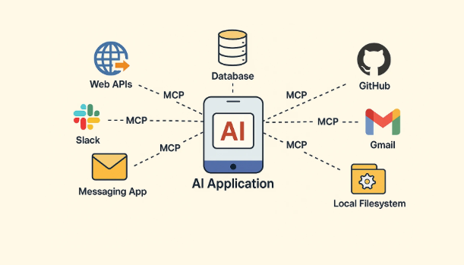

Slide 4
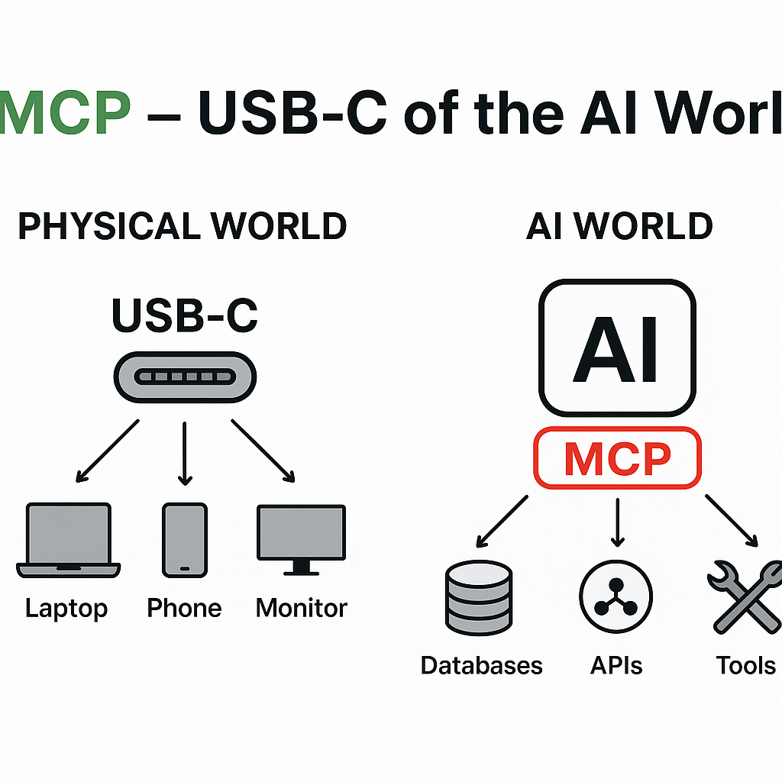
Think of MCP as the USB-C of the AI ecosystem.
Just like USB-C makes it easy for hardware devices to connect and share data or power,
MCP makes it easy for AI models to connect and share context with tools, APIs, and databases.

Slide 5
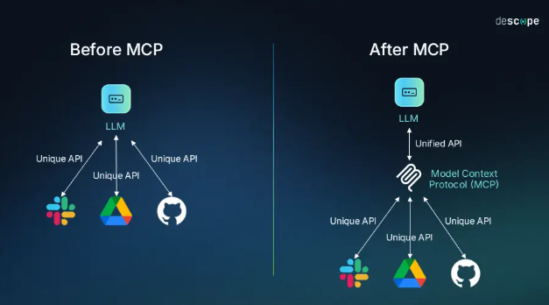

Slide 6


The M×N Problem
Before MCP, integrating AI models with external tools required creating custom connections for each combination
In AI systems, we often have:
M = Number of AI models or agents (e.g., GPT, Claude, Gemini, Llama)
N = Number of tools or data sources (e.g., APIs, databases, vector stores, plugins)
Without a standard like MCP, every model must be manually integrated with every tool. That leads to M × N integrations — a huge amount of repetitive work.

Slide 7
For example we have 4 AI models (GPT - 4,Claude.Gemini,DeepSeek) and 5 tools (GitHub, Slack, Google Drive, Salesforce, database)
Without MCP - 4 models * 5 tools = 20 connections
With MCP - 4 + 5 = 9 components

Slide 8
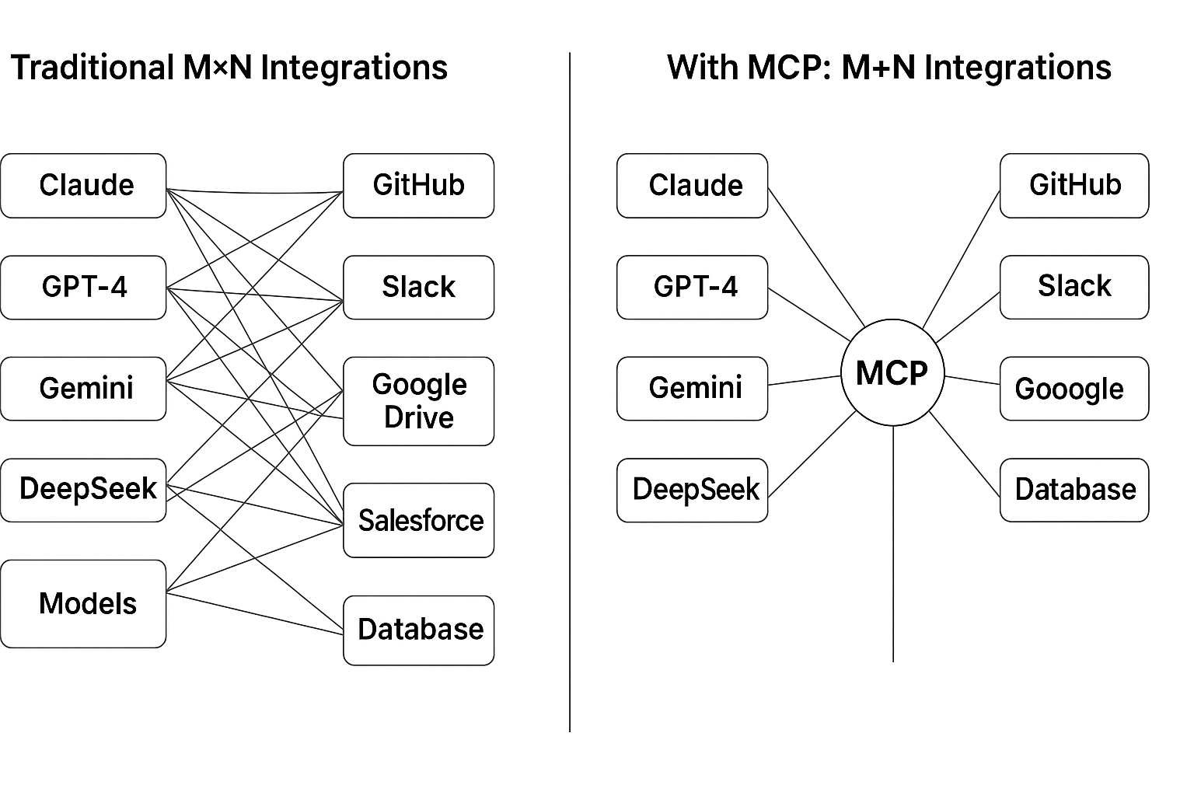

Slide 9
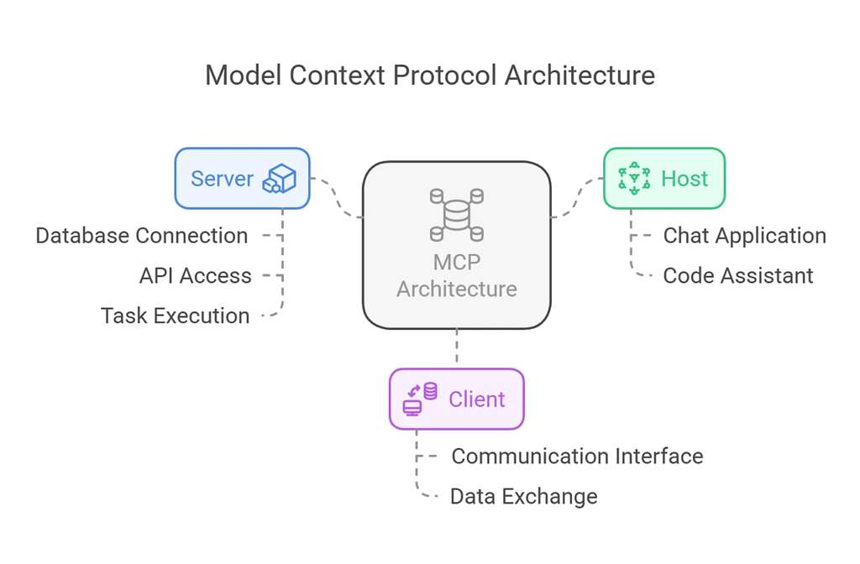
MCP Architecture

Slide 10
01
02
03
Server
Client
Host
The Server component handles the backend operations — everything related to data access, APIs, and computation.
The server provides the actual data and services that the model or application needs using MCP Primitives.
The Client represents the interface that communicates with the MCP system.
The client is like a messenger between the user or host application and the MCP system.
The Host represents the AI-powered application that interacts directly with users.
The host provides the user-facing environment where AI interacts with people.

Slide 11

MCP Primitives
Tools
Resources
Prompts
Executable functions or operations that the model can call.
Represent external data or services that can be accessed by the model.
Predefined instruction templates that guide the model’s responses.
A fetch_weather() tool, run_sql_query(), or generate_chart()
A “Weather API”, “Database”, or “Google Drive folder”.
A summarization prompt, a query prompt, or a code-generation prompt.

Slide 12
Example
User Request : What’s the weather in Delhi?
Prompt :
{
"id": "get_weather_prompt",
"template": "Use the `get_weather` tool to find the current weather for {{city}}."
}
Tool :
{
"tool": "get_weather",
"input_schema": { "city": "string" },
"output_schema": { "temperature": "number", "condition": "string" }
}
Resource :
{
"type": "resource",
"id": "weather_api",
"url": "https://api.weather.com/data"
}

Slide 13
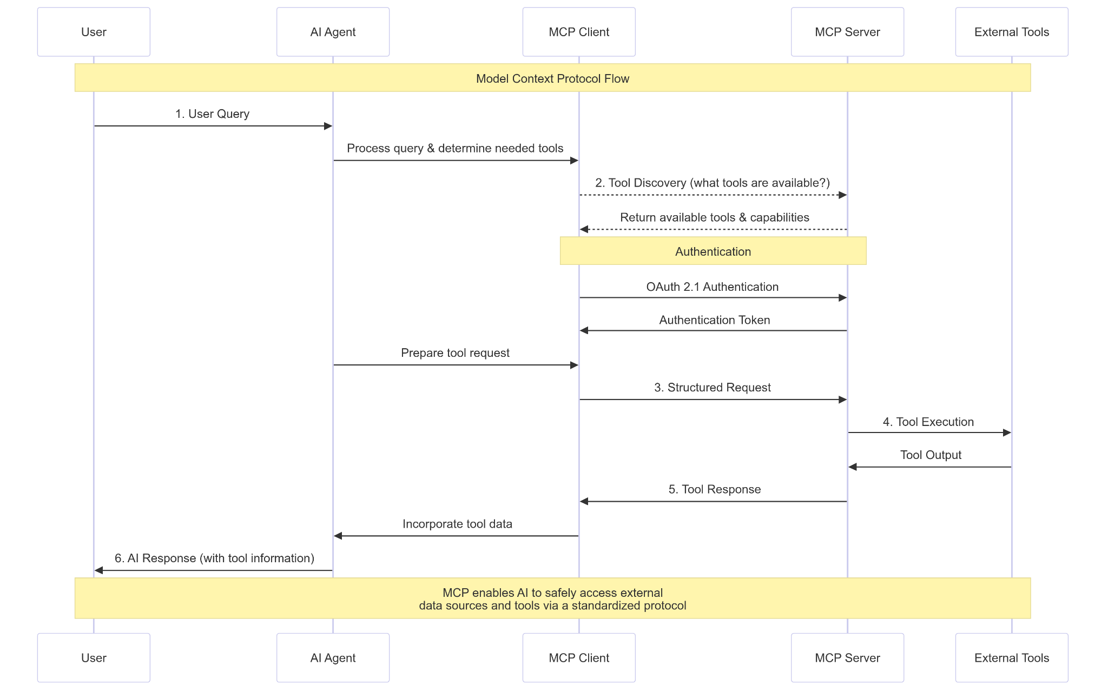

Slide 14

Thankyou

